Slide 1
Projektovanje tehnologije zavarivanja

Slide 2
Pipeline fabrication
Pipelines is used for coveyance of fluids (liquids and gases).
Two types of pipelines exist: magistral pipelines and pipelines inside industrial facilities.

Slide 3
Pipeline manufacturing comprises of:
Pipe fabrication
Pipeline accessories
Pipeline continuation

Slide 4
Pipe fabrication
Welded pipes (non-seamless) are fabricated by:
Press plate bending
Spiral pipe forming

Slide 5
Press plate bending:
With one weld seam
With two weld seams

Slide 6
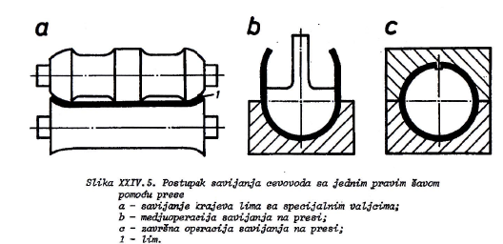
1. With one weld seam
The process of plate bending with one weld seam on a press:
a) Rolling-bending of plate edges
b) Bending of the plate central section
c) Finishing with upper mold
1 - plate

Slide 7
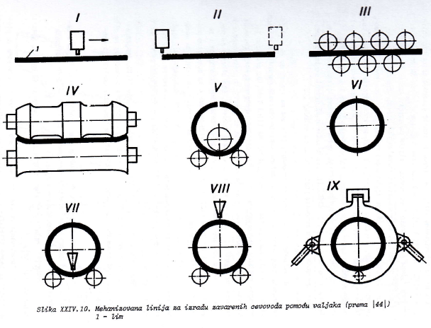
Phases:
Mechanised fabrication line for welded pipelines with rollers:
1 - plate

Slide 8
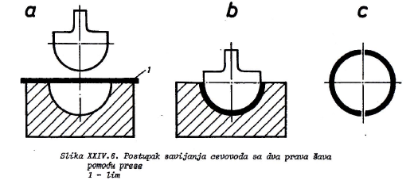
2. With two weld seams:
The process of plate bending with two weld seams:
1-plate

Slide 9
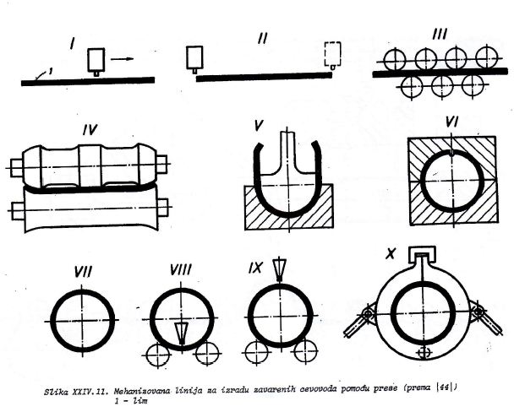
Phases:
Mechanised fabrication line for welded pipelines with rollers and the press: 1 - plate

Slide 10
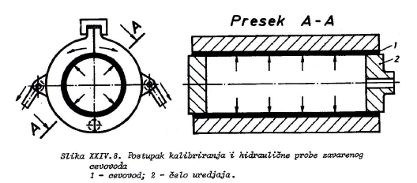
* Pipe calibration:
Calibration and hydraulic testing of the welded pipe:
1-pipe
2-calibrating piston

Slide 11
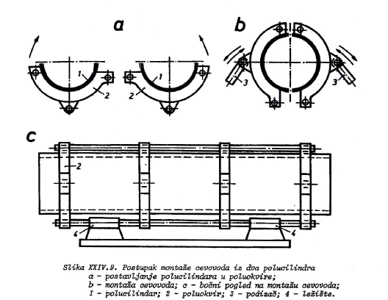
** Pipe halves positioning:
Pipe halves positioning :
pipe halves positioning in half-frames
Positioning of half-frames
side view
1 pipe-half; 2 half-frame; 3 frame arm; 4 frame rotation axis

Slide 12
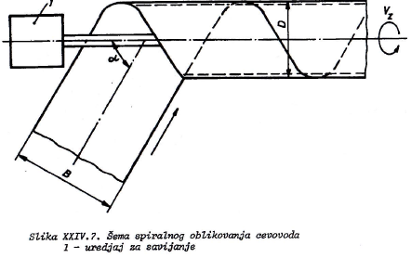
Spiral pipe forming:
It is used for large diameter pipelines.
Different pipe diameters can be obtained from the same plate width.
α=(40 – 66)º
B/D=2.35-1.25
Spiral pipe forming
1-bending device

Slide 13
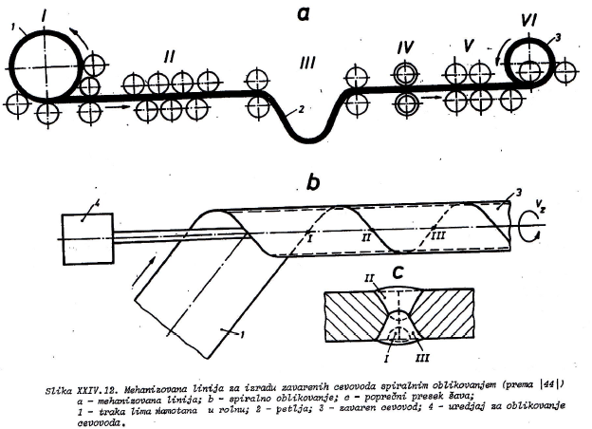
Phases:
Mechanised fabrication line for spiral pipe forming:
a-mechanized line, b-spiral forming, c-weld cross section, 1 – rolled sheet, 2-sheet compensating hang, 3-welded pipeline, 4-bending device

Slide 14
Pipeline accessories
Rebra krutosti
Pipeline supports
Compensators

Slide 15
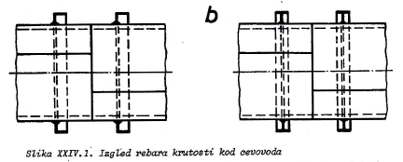
Stiffening ribs:
- Stiffening ribs are used for pipelines with diameters of over 1.5 m
Pipeline stiffening ribs

Slide 16
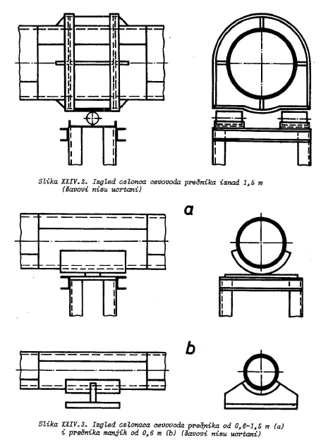
Pipeline supports –
used also for
compensating
heat dilatations
Roller pipeline support (diameter over 1,5 m)
Slide pipeline support: a) diameter of 0,6-1,5 m, b) diameter up to 0,6 m

Slide 17
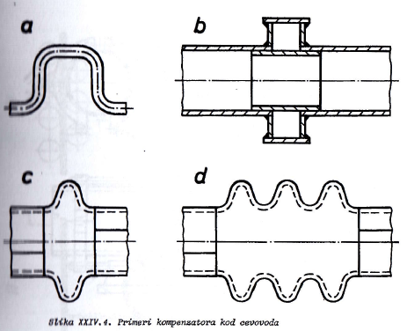
Compensators – head dilatation dilatation compansation

Slide 18
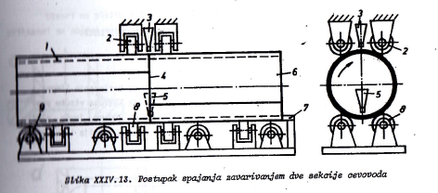
Pipeline continuation
Two pipe sections continuation by welding

Slide 19
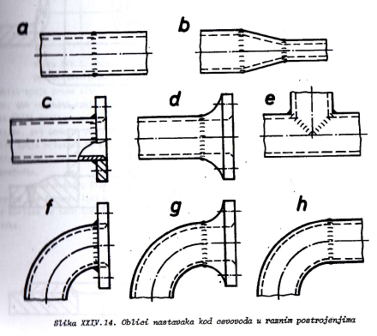
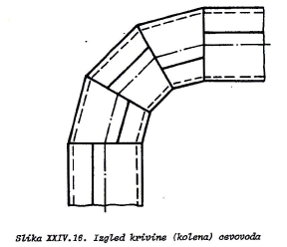
Small diameter pipeline continuation (a), diameter reduction (b), flanges (c,d), branch (e) and bends (f,g,h).
Large pipeline bend.

Slide 20
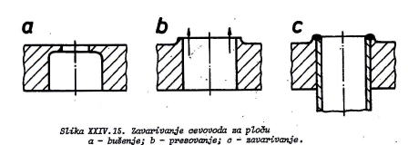
Pipeline welding to a pressure vessel or a plate:
Pipeline welding to a pressure vessel or a plate, fabrication steps: a-drilling, b-pressing (punching), c-welding

Slide 21
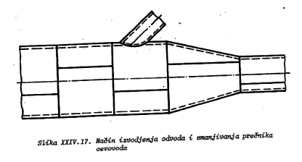
Branch and diameter reduction element fabrication:
Branch and diameter reduction element fabrication

Slide 22
Hvala na pažnji!

